Slide 1
A Primer on Using OpenDSS for Verifying Your Power System Simulations
Aryan Ritwajeet Jha
Notes:
Remember to hit the reset button to make sure all the page elements react properly.
There are 20 different layouts that you can choose from.

Slide 2

OpenDSS Introduction
OpenDSS is an Electric Power Distribution System Simulator (DSS).
It is Free, Open-source. It was originally designed by EPRI, and is now maintained/updated by it and the wider Power Systems community.
OpenDSS can perform:
Unbalanced, Multi-phase Powerflow
Quasi-Static Time-Series (QSTS) Simulations
Fault Analysis
Other capabilities include Harmonic Analysis, Flicker Analysis, Linear and Nonlinear Analysis, Stray Voltage/Current Analysis

Slide 3


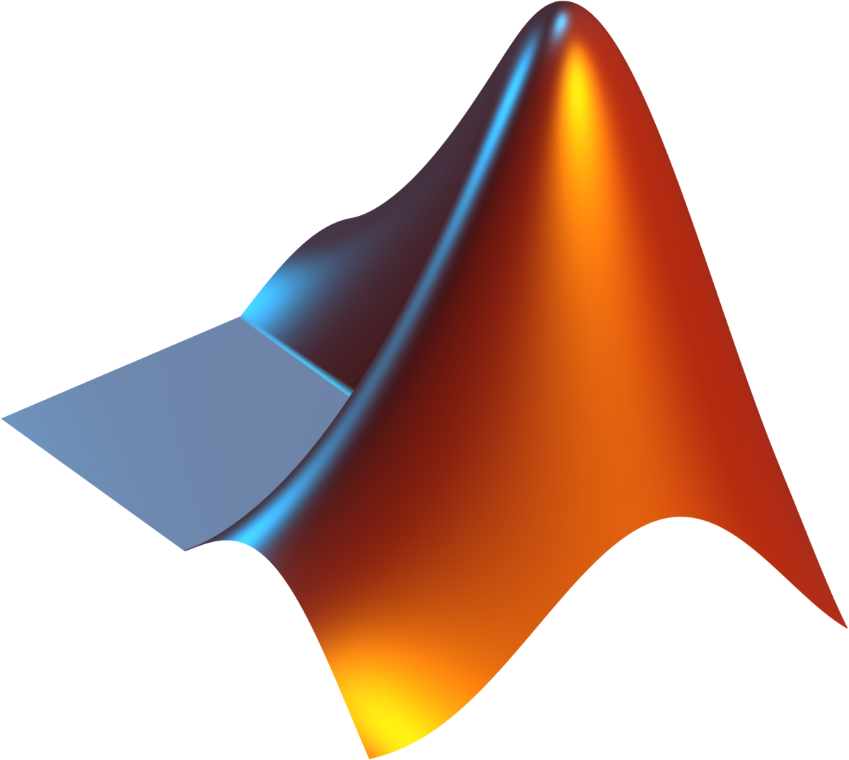

OpenDSS Introduction
It does NOT do:
Optimal Power Flow (it is not an optimization solver)
Basically, OpenDSS is an excellent compiler, parser and Powerflow solver, but is not an equivalent of a programming language.
Often, in order to do even slightly non-trivial tasks (which otherwise would require the user to do a lot of manual work), OpenDSS requires you to interface with it via a regular programming language).
Some languages are officially supported, but in theory any language can be used to script the creation of OpenDSS files, which subsequently may be run using the OpenDSS GUI.

Slide 4
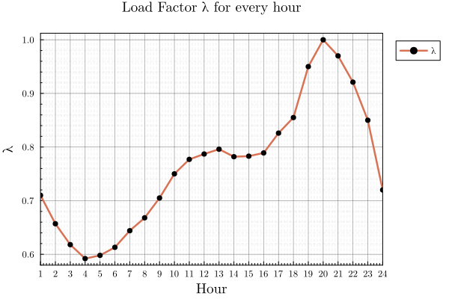
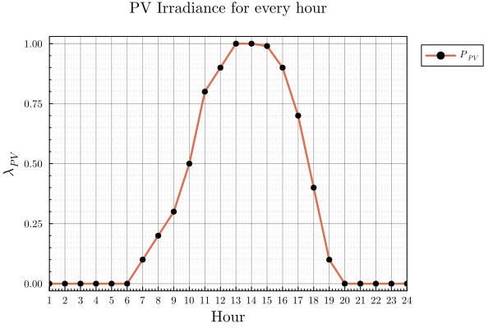
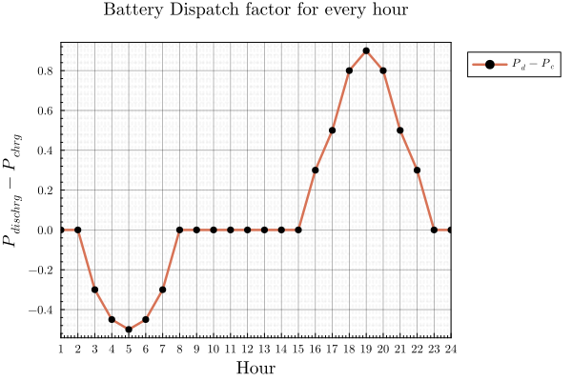
OpenDSS Introduction
OpenDSS offers very high modelling flexibility. You can have a system with
1-phase and/or 2-phase and/or 3-phase (really, any n-phase) components
Transformers, Relays, Reactors, Capacitors
Generators, PVs, Storage, Inverters
Control Elements to control PVs, Storage, etc.
Custom profiles for each element, say load variation, PV real-power variation, Battery Charging/Discharging cycles
And it will just solve for the powerflows! (And allows for exporting of key variables/time-series)

Slide 5
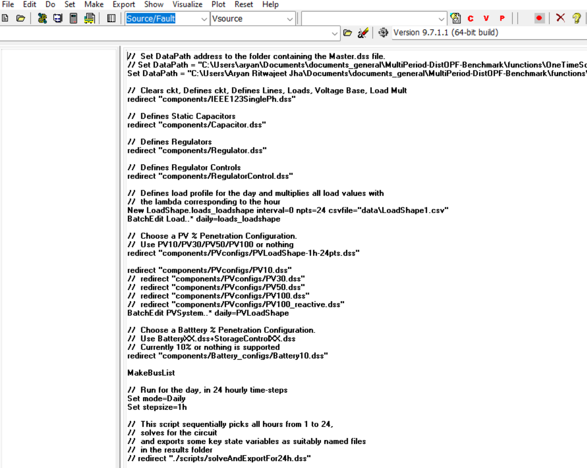
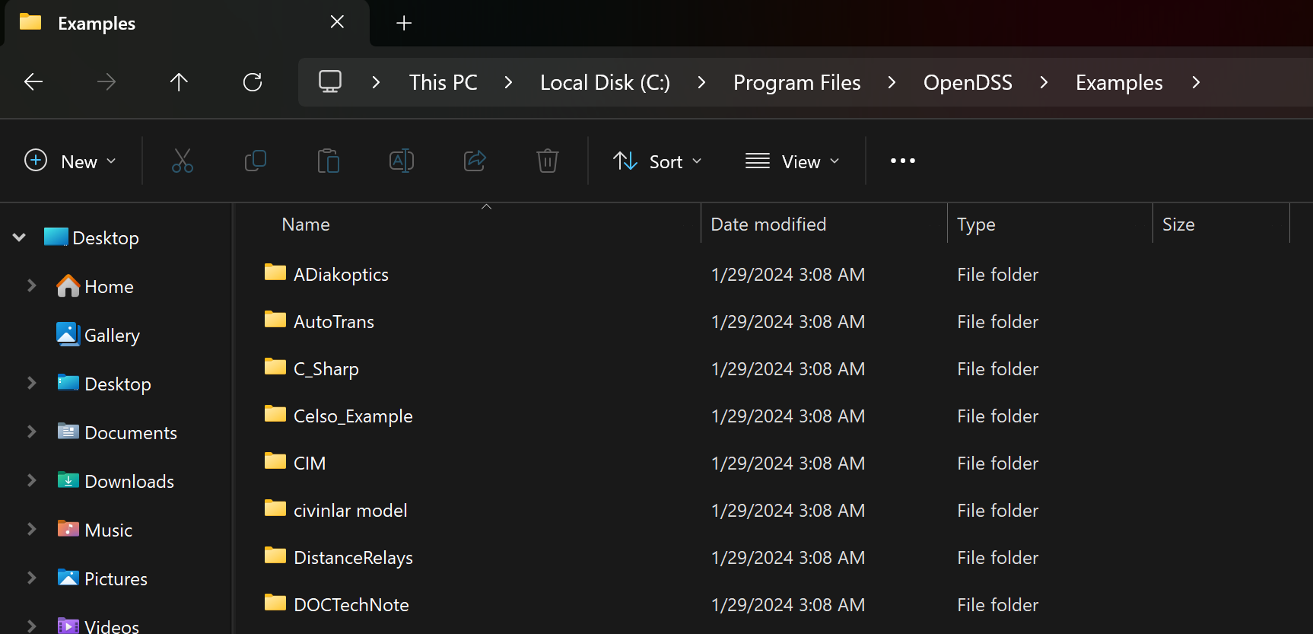
How can I easily see OpenDSS’s capabilities myself?
Simple. Download OpenDSS.
Go to the Examples folder in its directory
Open any file of your interest in OpenDSS

Slide 6
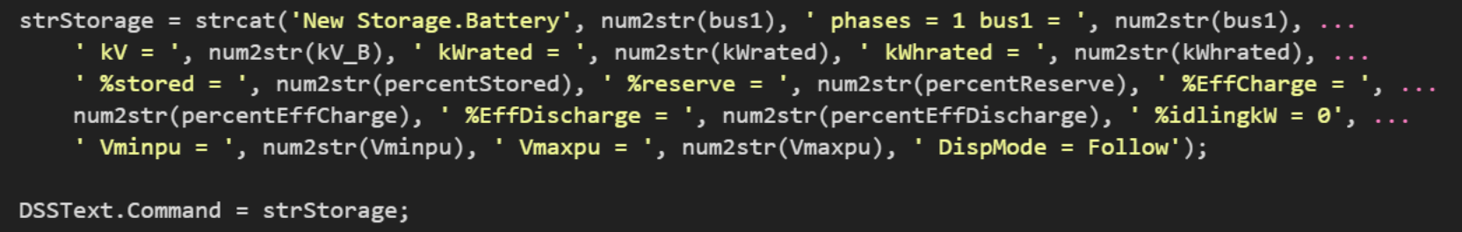
How can I model my own system?
OpenDSS isn’t a full-fledged programming language (e.g. it does not have a for loop or an if condition or a capability of string manipulation)
Install the COM/OpenDSSDirect interface for your language
Define all your components via OpenDSS commands (Basically you make strings containing the lines of codes interpretable by OpenDSS)

Slide 7
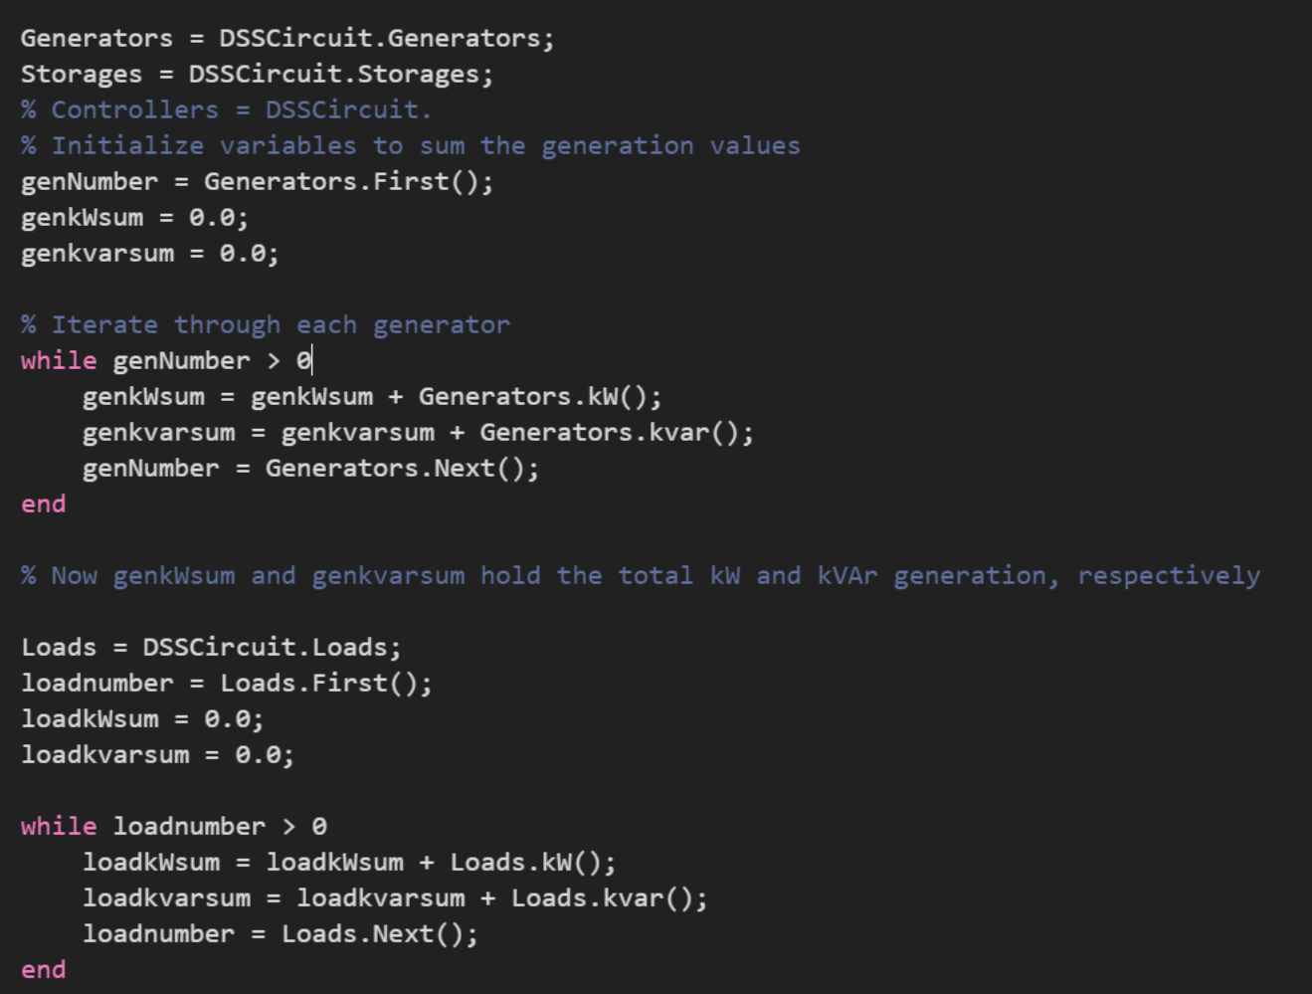
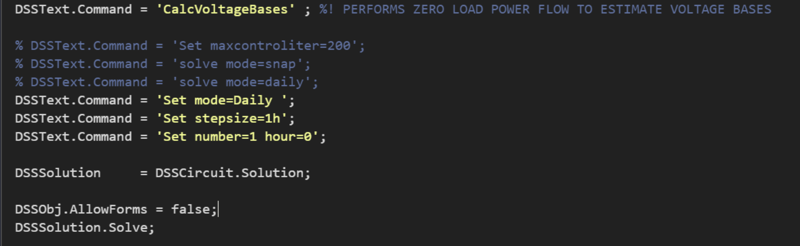
How to run Powerflow for my system and export relevant data?
Just run a ‘solve’ command on the circuit you’ve defined.
Once the solution is obtained, you can check out any results for any components you’d like, generate CSV files for them, and plot them.
Here is a repo where the COM interface is utilized with MATLAB to define and run a system.

Slide 8
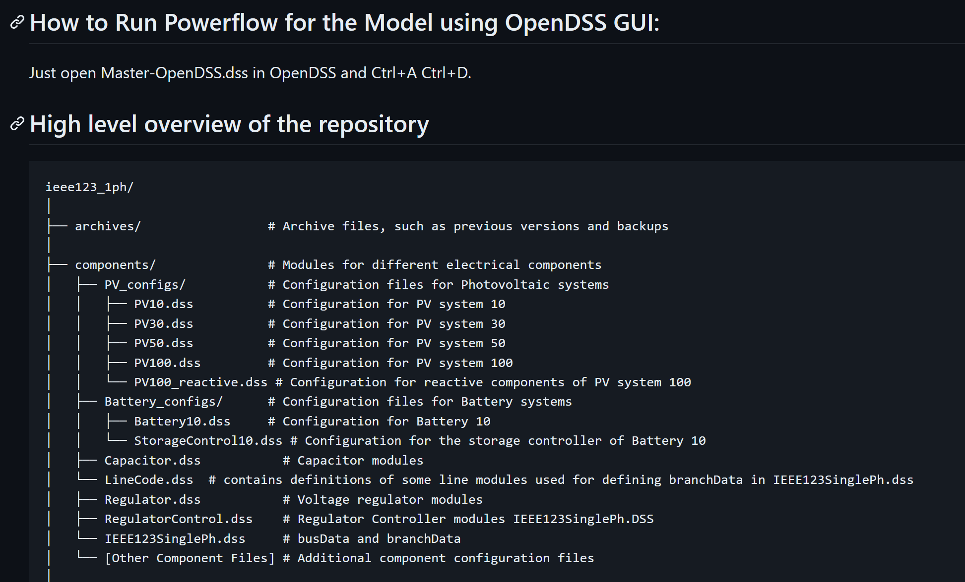
Running the Model using OpenDSS GUI
In theory, you can make all the scripts before-hand, and export them all as .DSS files so that someone who can only run OpenDSS GUI can still run them.
This repo is an example.

Slide 9
Final note
OpenDSS is a very powerful tool to verify simulation.
It has some idiosyncrasies which can at times appear unintuitive (for me some stuff still is)
Dead links every now and then (sourceforge forum is the only forum where questions are answered)
This is not so bad in comparison (PSSE)
Many seemingly routine procedures don’t have an easy-to-use API, so you kind of have to create your home-made script sometimes or apply manual labour (copy-pasting Monitor exports because you cannot specify a destination folder, changing inverter reactive power output for every hour using a for loop, because there isn’t a functionality to use an array).

Slide 10

Thank You.

